Slide 1




21.12 Release
@RAPIDSai
https://github.com/rapidsai
https://rapids-goai.slack.com/join
https://rapids.ai
Notes:
https://rapids.ai/ https://github.com/rapidsai
https://docs.rapids.ai/overview

Slide 2
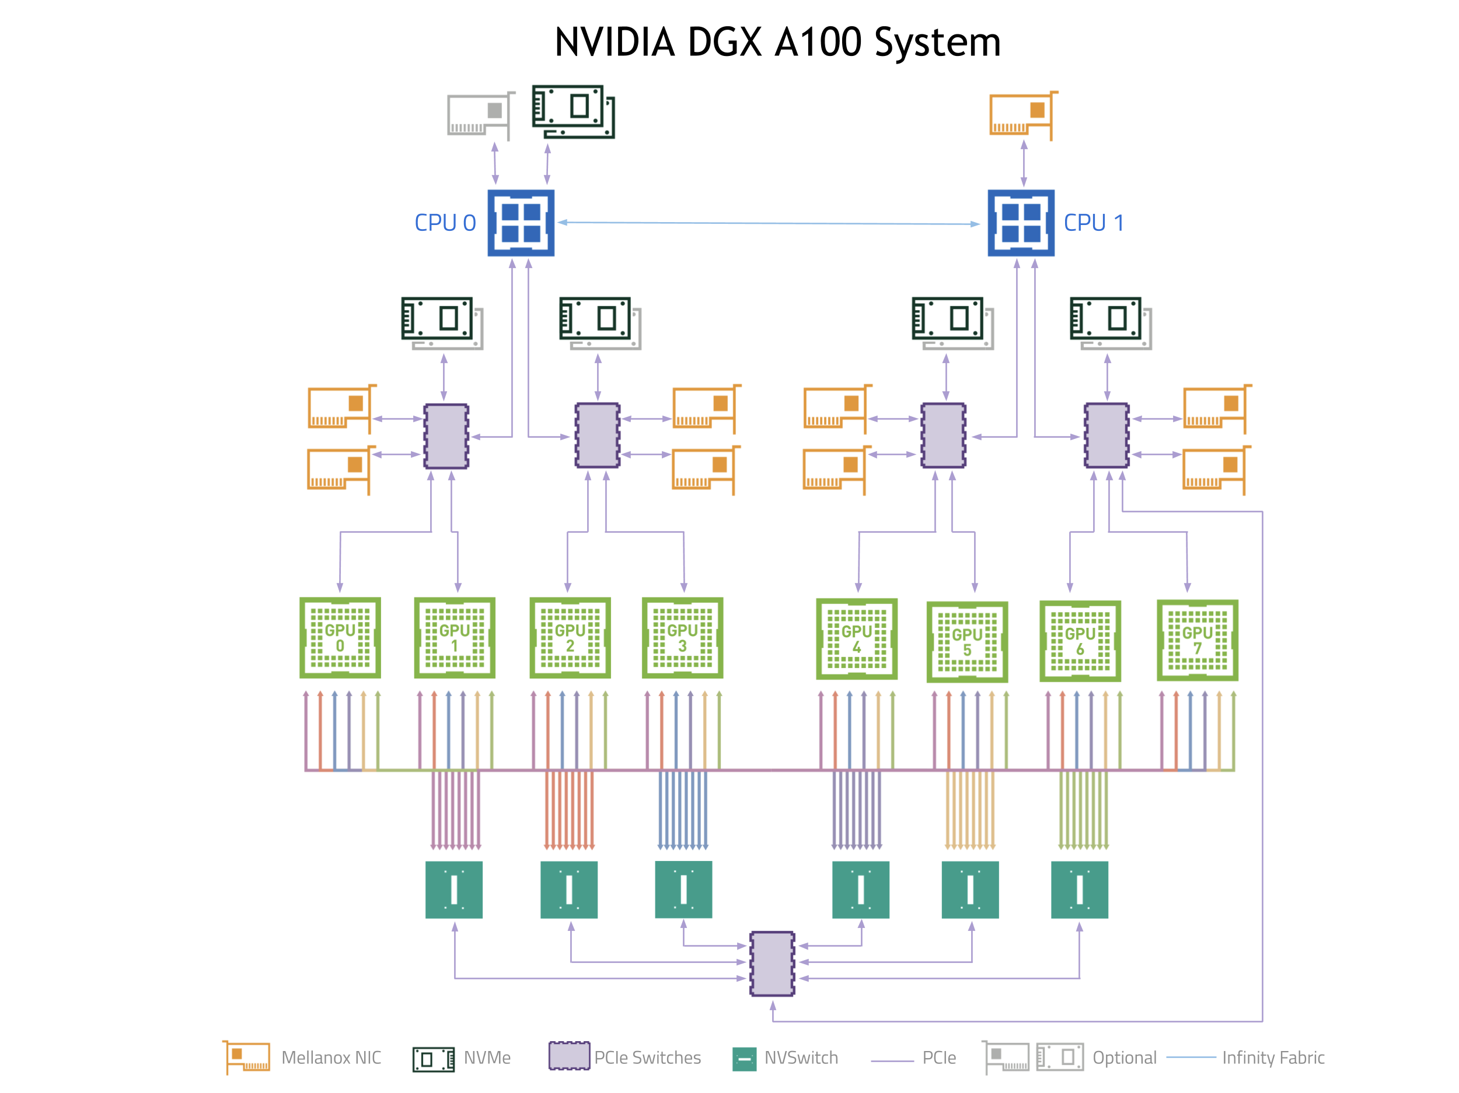
Why GPUs for Data Science?
Numerous hardware advantages
Thousands of cores with up to ~20 TeraFlops of general purpose compute performance
Up to 1.5 TB/s of memory bandwidth
Hardware interconnects for up to 600 GB/s bidirectional GPU <--> GPU bandwidth
Can scale up to 16x GPUs in a single node
Almost never run out of compute relative to memory bandwidth!

Slide 3
What is RAPIDS?
End-to-End GPU Accelerated Data Science
Data Preparation/ETL
Analytics/ML/Graph
Visualization
cuDF
GPU-accelerated ETL functions
Tracks Pandas and other common PyData APIs
Dask + UCX integration for scaling
RAPIDS ML
GPU-native cuML library, plus XGBoost, FIL, HPO, and more
cuGraph
GPU graph analytics, including TSP, PageRank, and more
cuxfilter
GPU-accelerated cross-filtering
pyViz integration
Plotly Dash, Bokeh, Datashader, HoloViews, hvPlot
Domain-Specific Libraries
CLX + Morpheus Cyber log processing + anomaly detection | cuSignal Signals processing | cuSpatial Spatial analytics
cuStreamz Streaming analytics | cuCIM Computer vision & image processing primitives | node-RAPIDS Bindings for node.js
...and more!

Slide 4
Overview of Changes: RAPIDS 21.12 Release
RAPIDS CUDA enhanced compatibility is now supported by RAPIDS–users can now use newer CUDA binaries or runtimes without updating their CUDA driver version (450.80.02+).
RAPIDS+Dask Support for spilling on demand; Deprecation of support for UCX version less than 1.11.1
cuDF 128 bit Decimal support; Groupby diff; Map support for ORC writer; String now has support for istitle; mixed numeric type support in to_dlpack; Resample function added to cuDF; pandas-like UDF interface with DataFrame and Series.apply;
cuML New LinearSVC and LinearSVR models; Dask-SQL support for cuML models; exogenous variable support in ARIMA; KL divergence exposed in TSNE;
cuGraph K-core for undirected graphs for single and multiple GPUs; graph primitive filter for edges; transpose_edgelist and symmetrize_edgelist and count number of self loops and multi-edges in a graph in libcugraph; Improved performance for NetworkX inputs; Initial implementation of Multi GPU HITS;
Dask-SQL Experimental GPU support for Dask-SQL, bringing the power of RAPIDS to SQL

Slide 5
cuDF Updates: Deep Dive
Release 21.12
Features added in 21.12
128 bit Decimal support in libcuDF
Diff is now supported for groupby
Map support for ORC writer
Support for Series.str.istitle
pandas-like UDF interface with DataFrame and Series.apply
Handling of mixed numeric types supported in to_dlpack
Resample function added to cuDF will allow users to resample time series data
cuDF’s Grouper function now supports grouping via time frequency
Planned Upcoming Features
Expanded support for 128 bit decimal types
Nested type support for JSON reader
Decimal support for Dask cuDF Parquet reader
Refactored hash join implementation
Notes:
Medium blog title : Lookout, nested types are now supported in RAPIDS cuDF!

Slide 6
cuML Updates: Deep Dive
Release 21.12
Features added in 21.12
Support for LinearSVM using QN solvers, LinearSVC and LinearSVR models
Ability to use Dask-SQL with cuML models
ARIMA now supports exogenous variables
KL divergence exposed in TSNE
Planned Upcoming Features
Multiple improvements to T-Distributed Stochastic Neighbor Embedding algorithm to improve accuracy
Enhancements to Random Forest Algorithm
Symbolic classification and regression models

Slide 7
cuGraph Updates: Deep Dive
Release 21.12
Features added in 21.12
Implemented K-core for undirected graphs for Single and Multi GPUs
Initial implementation of Multi GPU HITS
Initial version of node2vec in C++/CUDA for graph sampling, Python wrapper coming soon
New graph filter for the edges, extract_if_e, in libcugraph
Implemented transpose_edgelist and symmetrize_edgelist in libcugraph
Added the ability to count number of self loops and multi-edges in a graph, in libcugraph
Improved performance when a NetworkX graph is passed in
Planned Upcoming Features
Multi-GPU graph primitives for Triangle Counting
More algorithms poerted to using primitives and scaling to Multi GPUs
Ability for user to write custom algorithms using the graph primitives
Multi GPU neighborhood sampling
Property Graphs

Slide 8




Join the Conversation
GOOGLE GROUPS
DOCKER HUB
SLACK CHANNEL
STACK OVERFLOW
https://groups.google.com/forum/#!forum/rapidsai
https://hub.docker.com/r/rapidsai/rapidsai
https://rapids-goai.slack.com/join
https://stackoverflow.com/tags/rapids

Slide 9
THANK YOU
@RAPIDSai
Notes:
https://rapids.ai/ https://github.com/rapidsai
https://docs.rapids.ai/overview

